Slide 1
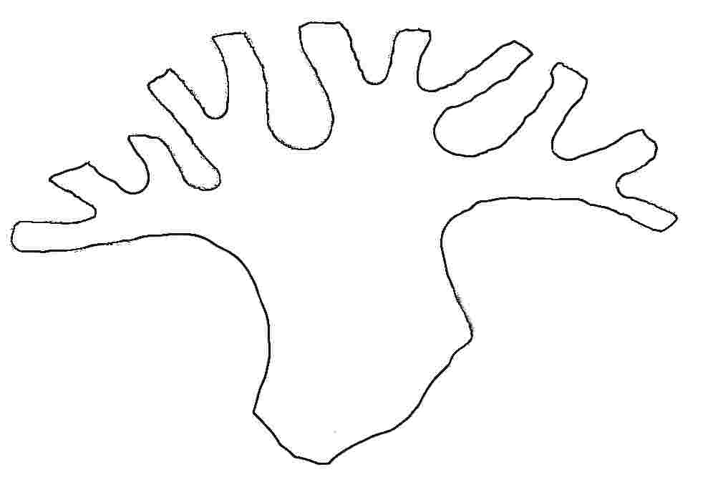
The History Tree
Notes:
Introduce session. Suggestion
“We have been provided with some resources that will help us look at historical events and historic figures within our local area. An organisation called the North Yorkshire Moors Association – NYMA - has provided us with this information. Their project is called The History Tree”

Slide 2
By the end of this session you will be able to:
Identify key aspects of ‘The History Tree Project’.
Name some historic events between 1802 & 2006.
Describe one or two historic events between 1802 & 2006.
Summarise the ‘History Tree Project’.
Notes:
Objectives for session, working up Blooms Taxonomy.

Slide 3
Who, when, what, why and how?
Who and when?
NYMA is a Charity set up in 1985
What?
It supports the North York Moors National Park Authority to protect and enhance the North Yorkshire Moors
Why?
So that people now and in the future can enjoy the Moors
How?
It campaigns against things that might damage the Moors such as industrial developments.
It carries out projects to increase knowledge of the North York Moors, such as the History Tree Project.
Notes:
Explain who and what NYMA is with the info above. Explain that the National Park is managed by the National Park Authority and that NYMA is a group of volunteers who run projects in support of it.

Slide 4
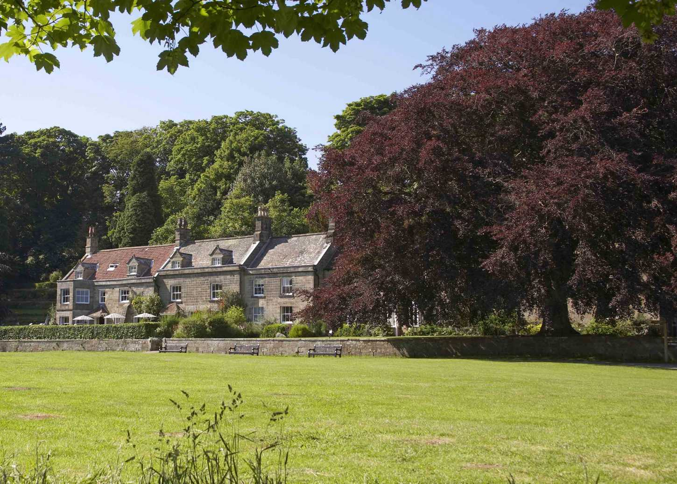
Ancient Copper Beech Tree
The Danby Moors Centre
Notes:
Background info for slide:
The North York Moors National Park has an information centre in Danby.
In front of the Moors Centre was a very large copper beech tree which became diseased and needed to be felled.
The tree was approximately 200 years old.
(Forthcoming slides will encourage discussion on age of tree and reasons for felling. So at this point don’t divulge info.)

Slide 5
How can you tell a tree’s age?
How old are
you please?
Notes:
Invite responses to question.
Likely that someone will say ‘count the rings’

Slide 6
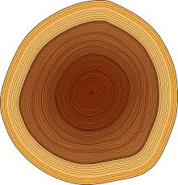
Activity time - 1
In pairs or groups work out how old the copper beech tree was.
Use your worksheet to help you.
You can use either or both methods.
1.5 metres (150cm)
Notes:
Give pupils hand-out to do the above task, they can use either or both methods.
Answer is approx 200 years old.

Slide 7
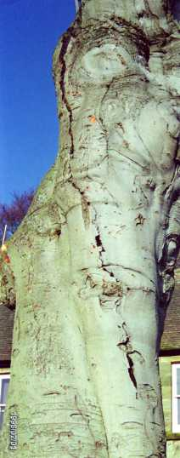
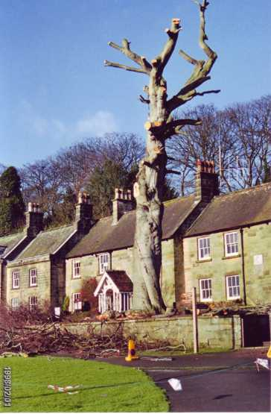
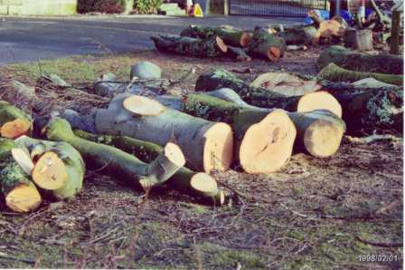
Why do you think the tree was taken down?
Notes:
Again, invite discussion.
Key reasons:
It was diseased
It could have fallen on the building and damaged it, and because the Moors Centre is a place that lots of people work and visit, it could have fallen on someone and injured or killed them. Can link to Science Curriculum – forces/gravity.

Slide 8
Activity time - 2
On your worksheet write down two reasons why the tree needed to be taken down.
Notes:
Self-explanatory
Pupils to complete worksheet.

Slide 9
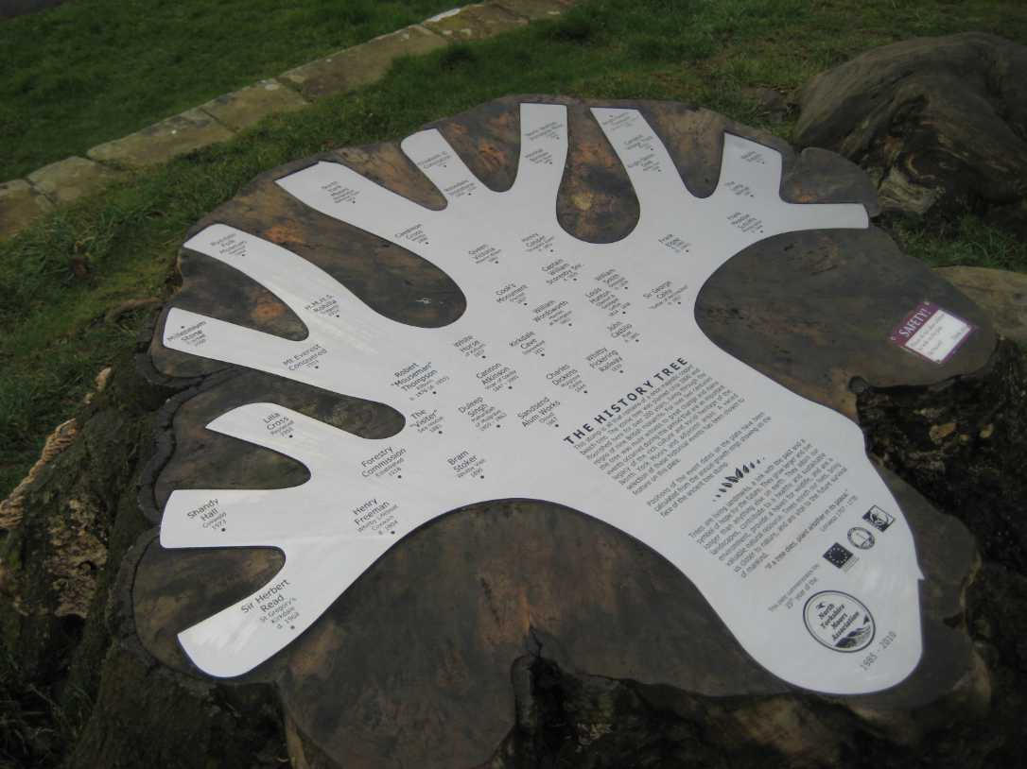
The History Tree Project
A plaque was made to celebrate the 25th Anniversary of the North Yorkshire Moors Association
It was fixed on the tree stump
but then ……
Notes:
NYMA had its 25th Anniversary in 2010 and to commemorate this they had a stainless steel plaque made.
It was etched with the dates and names of significant people and events from the 200 years that the old copper beech tree lived.
It was then fixed in place on the tree stump

Slide 10
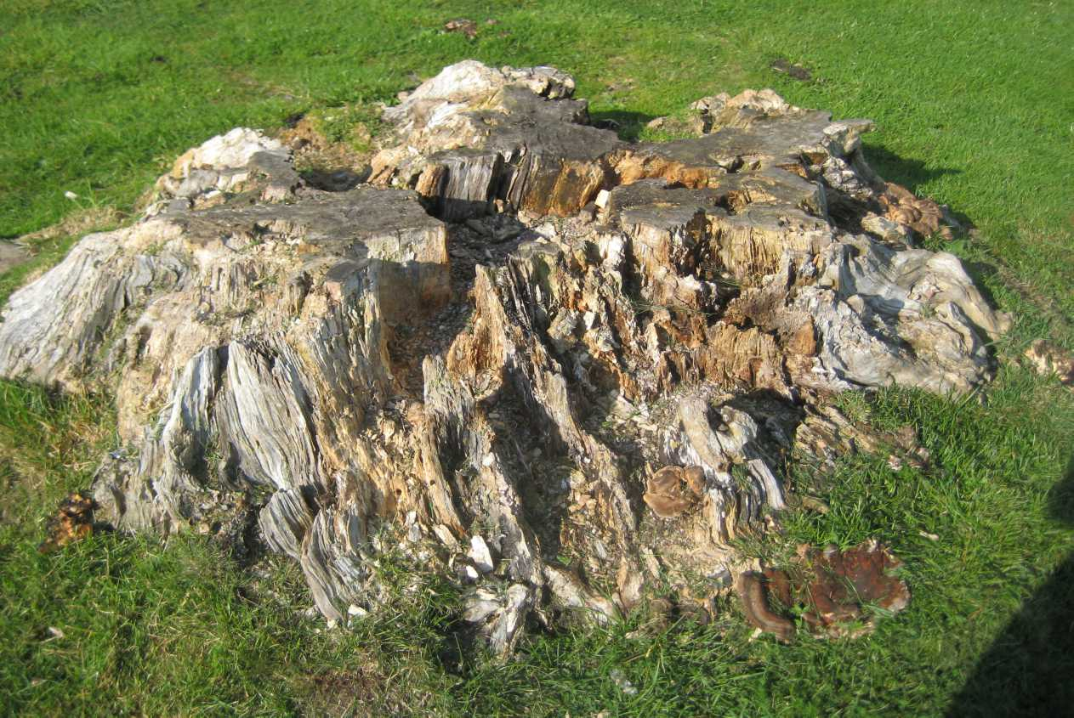
…...this happened!
Notes:
As happens in nature, the tree stump rotted and NYMA had to decide what to do next.

Slide 11
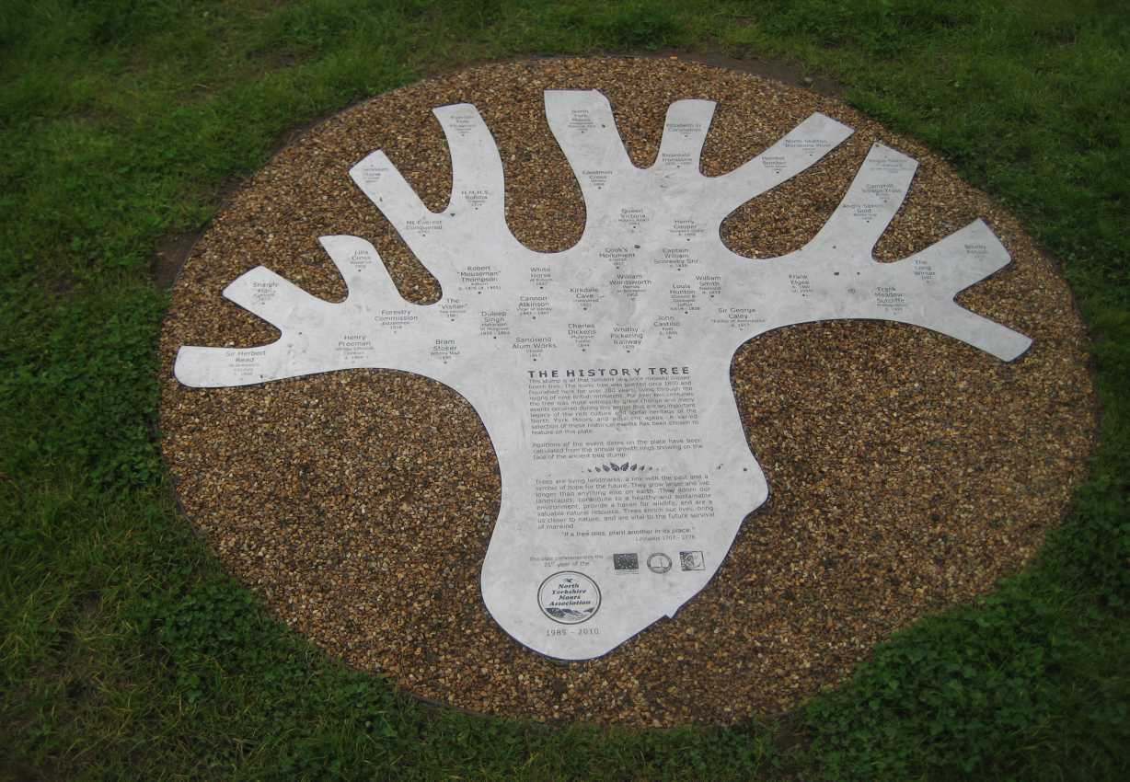
History Tree plaque in new position.
Notes:
The plaque now has a new position in front of the Danby Moors Centre, this time on a gravel-covered concrete base, surrounded with a metal hoop.

Slide 12
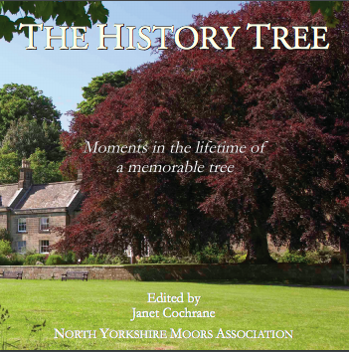
The History Tree Book
Notes:
Image shows the front cover of the History Tree Book.
Background to book.
The History Tree Project was developed and NYMA was given funding to produce a book of 40 chapters illustrating the events and significant people named on the plaque.
The Education Project that the pupils are working on is part of the History Tree Project.

Slide 13
Activity time - 3
Have you been listening?
On your worksheet
complete the ‘gapped’ exercise.
Notes:
Self-explanatory
Pupils to complete ‘gapped’ exercise on worksheet.

Slide 14
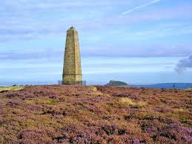
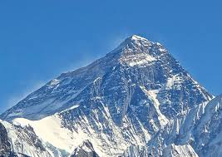
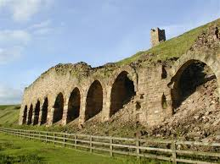
Historical events between 1802 & 2006
How many of these can you name?
Notes:
Invite discussion. Pupils to identify images, expand info where possible – stretch and challenge.

Slide 15
Activity time - 4
Make your own history tree
Using your sheet of ‘events’, complete your tree on your worksheet.
Pick any 5-10 ‘events’ and write them on your tree. Work your way up the tree by starting with the oldest event at the bottom...
Notes:
Provide each pupil with a list of ‘events’
Carry out task above. Differentiated for level – use own discretion.

Slide 16
Activity time - 5
Work in pairs or groups
Using one or two of the topics you have been given, take turns reading through a section and then complete the questions underneath.
You can work together to find the answers but please complete an answer sheet each.
Notes:
Again, task is self-explanatory.
There are sixteen chapters of the book which have been simplified.
Some chapters are more challenging than others. Some are purely comprehension, so there are additional questions to support the info.
There has been effort where possible to link to KS2 curriculum.
Suggestion is that pupils tackle 1 or 2 topics. More advanced pupils may be able to manage 3 if time allows.

Slide 17
Questions and Answers
What can you remember?
Notes:
Use various methods of questioning. Stretch and challenge according to level.

Slide 18
Extension Task
In groups make a poster/leaflet/PowerPoint on the ‘History Tree’
Things to include:
Description of the project
Information about significant people and events (from your work on the chapters)
Pictures and colour
Notes:
It is likely that this task may be appropriate for a further session/s – perhaps a further project within school that may draw on the expertise of teachers and link to other areas of the curriculum.
Use own discretion.
Differentiated tasks for different methods and levels of learners.

